Slide 1
Input Layer
LeakyReLU
Tanh
…
…
…
…
128
256
512
1024

Slide 2
Input Layer
Hidden Layer
…
…
…
…
128
256
512
1024

Slide 3
Generator
128
256
512
1024
…
…
…
…
LeakyReLU
Tanh

Slide 4
Discriminator
512
256
256
1
…
…
…
LeakyReLU
sigmoid

Slide 5
Generator
128
256
512
1024
…
…
…
…
LeakyReLU
Tanh

Slide 7
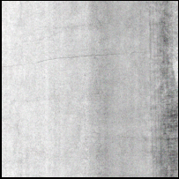


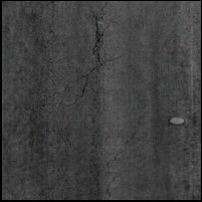
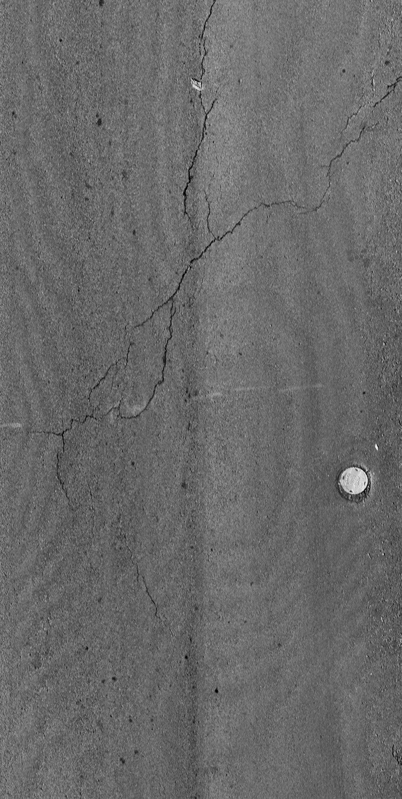
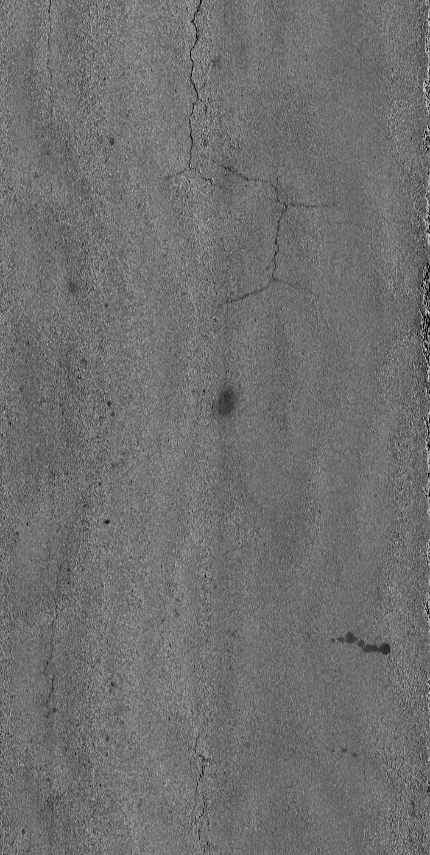
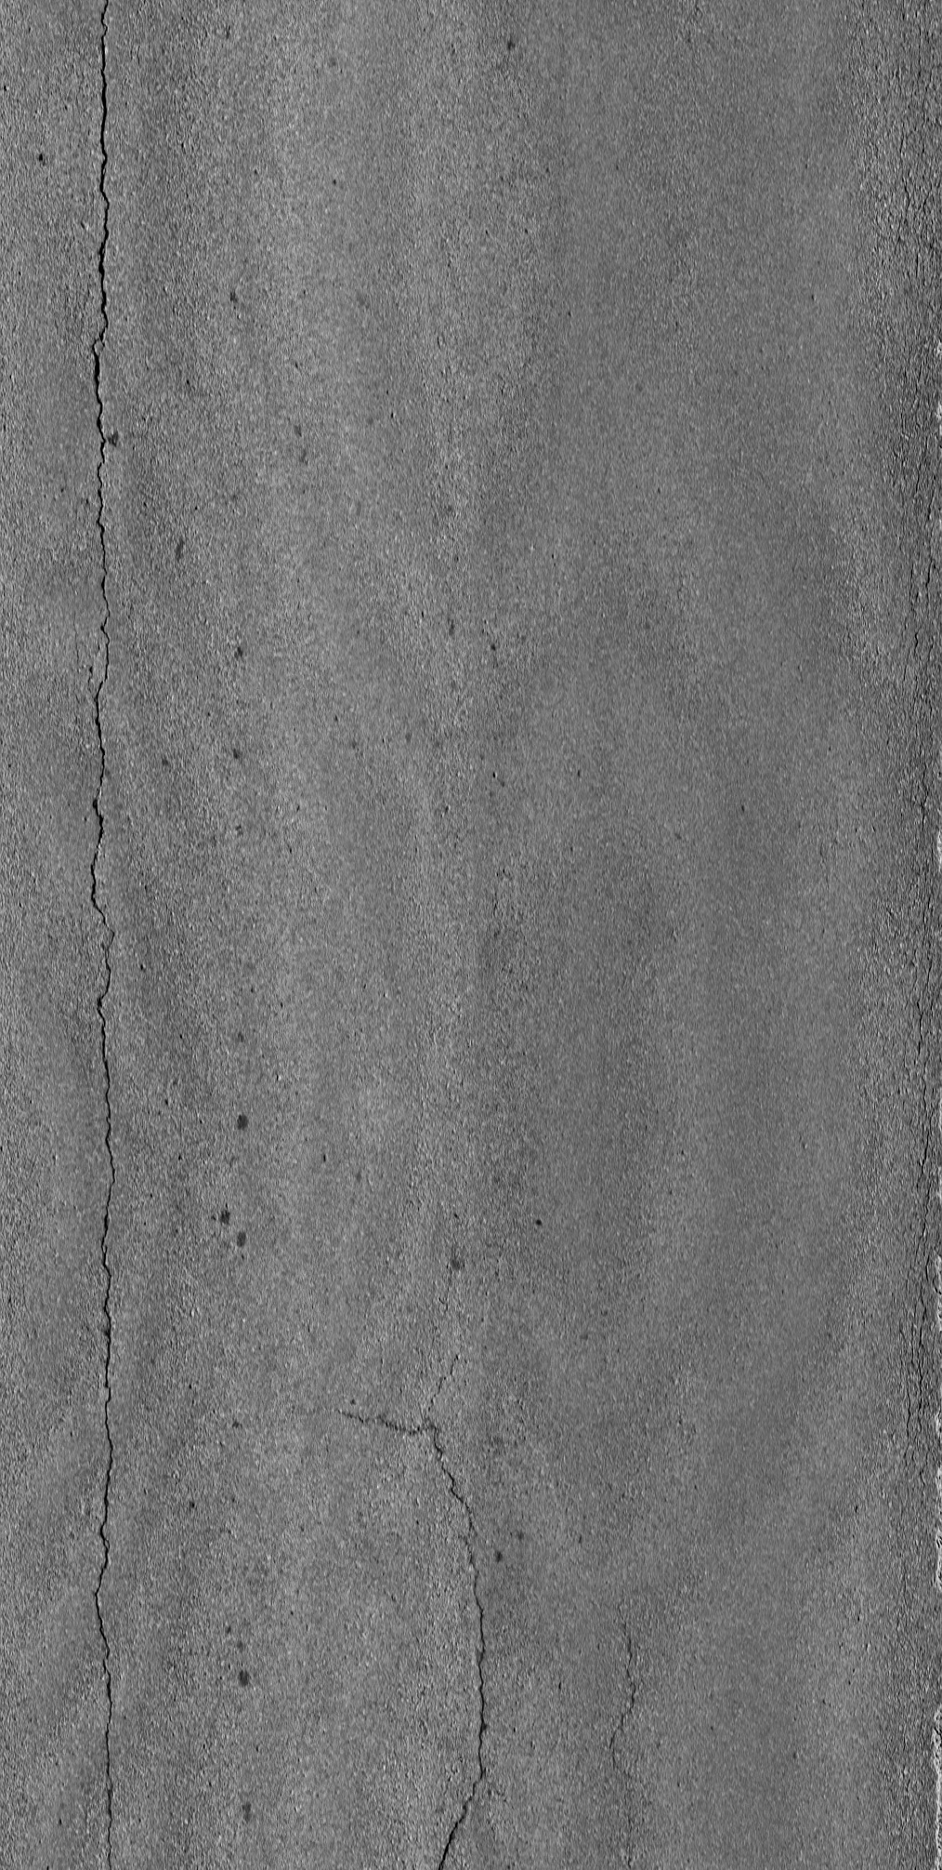
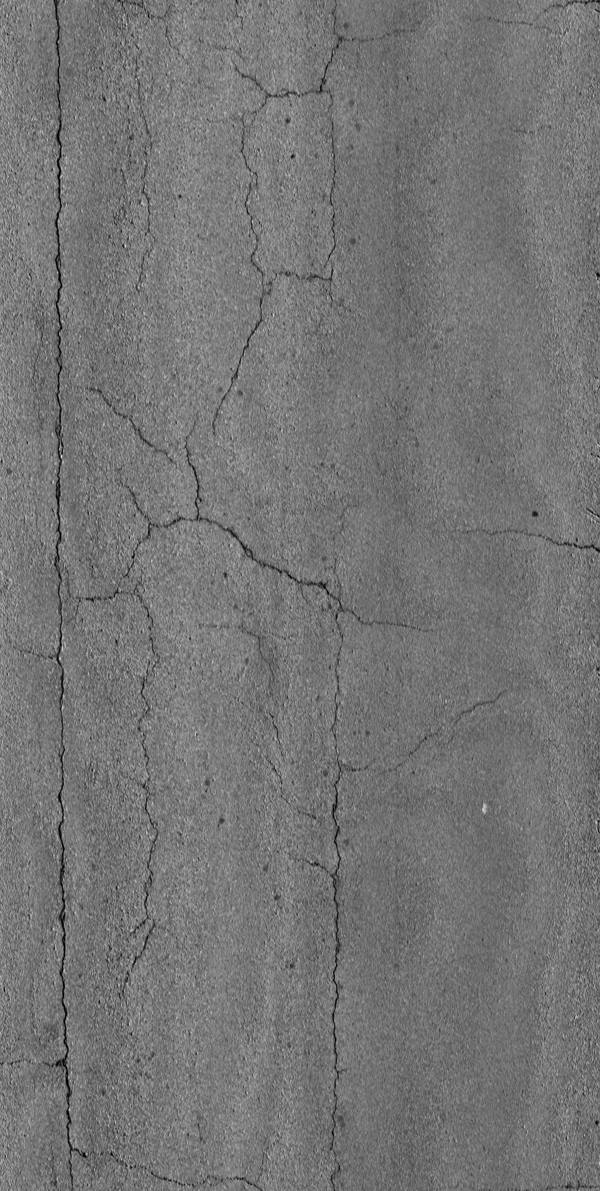
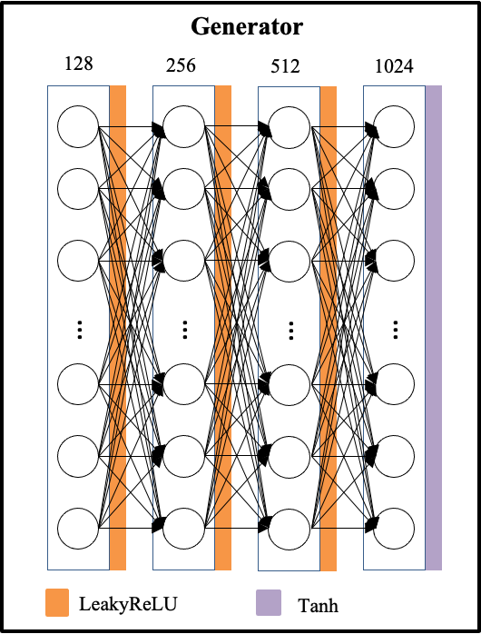
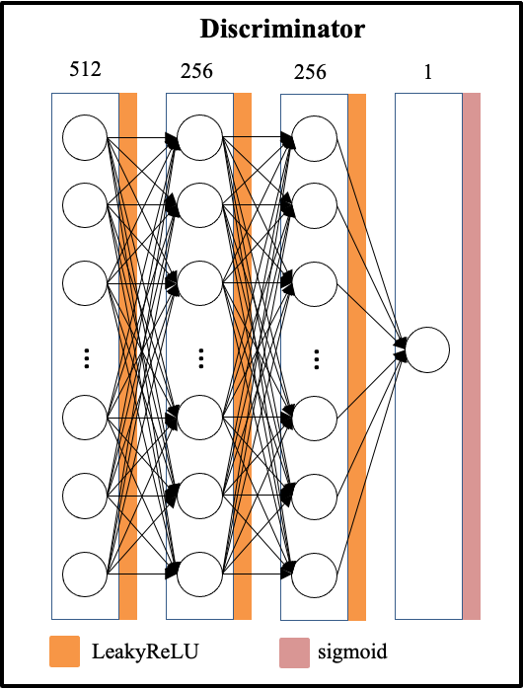
Generator
Discriminator
128
512
LeakyReLU
LeakyReLU
256
256
LeakyReLU
LeakyReLU
512
256
LeakyReLU
LeakyReLU
1024
1
Tanh
Sigmoid

Slide 8
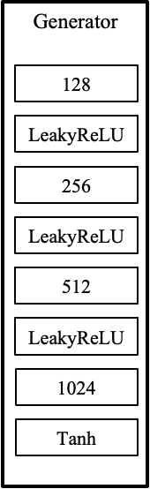
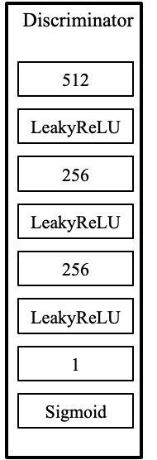
Random input vector
Update model
Fake images
Real/fake
Real images
Update model

Slide 9
Random input vector
Generator
Update model
Fake images
Discriminator
Real/fake
Real images
Update model

Slide 10
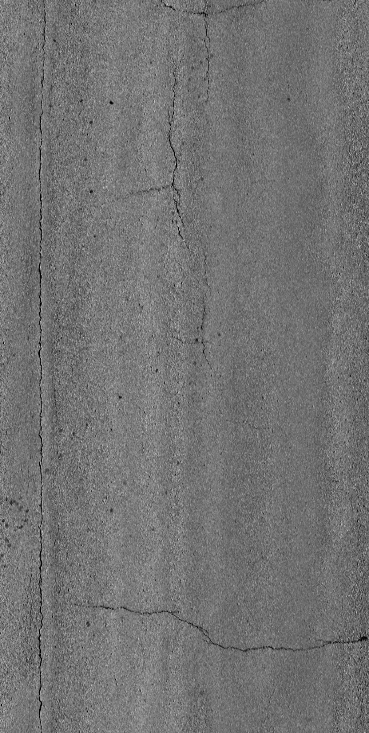
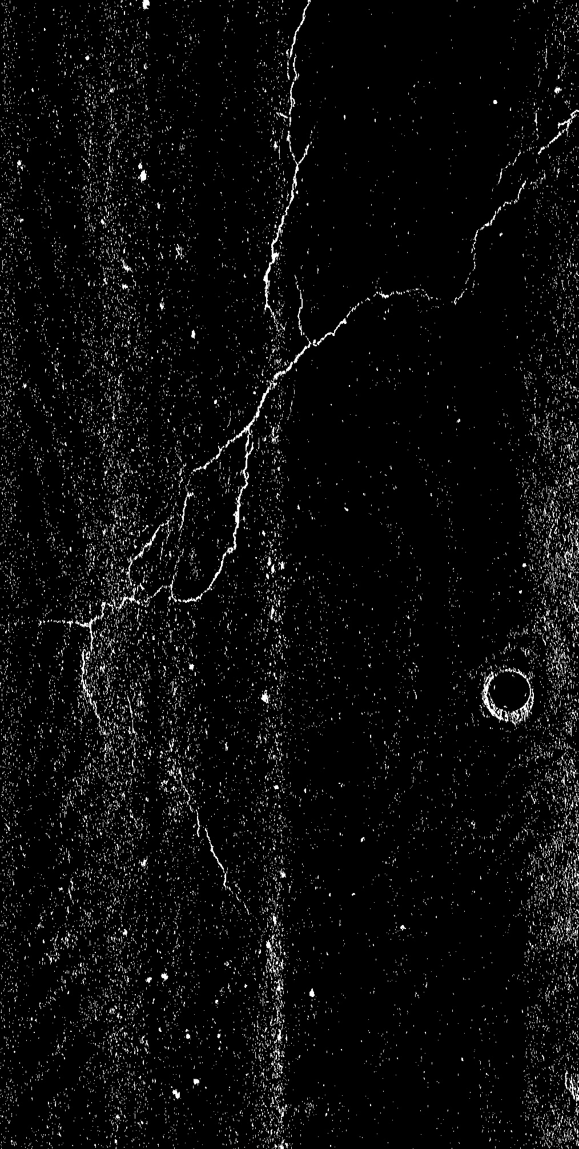
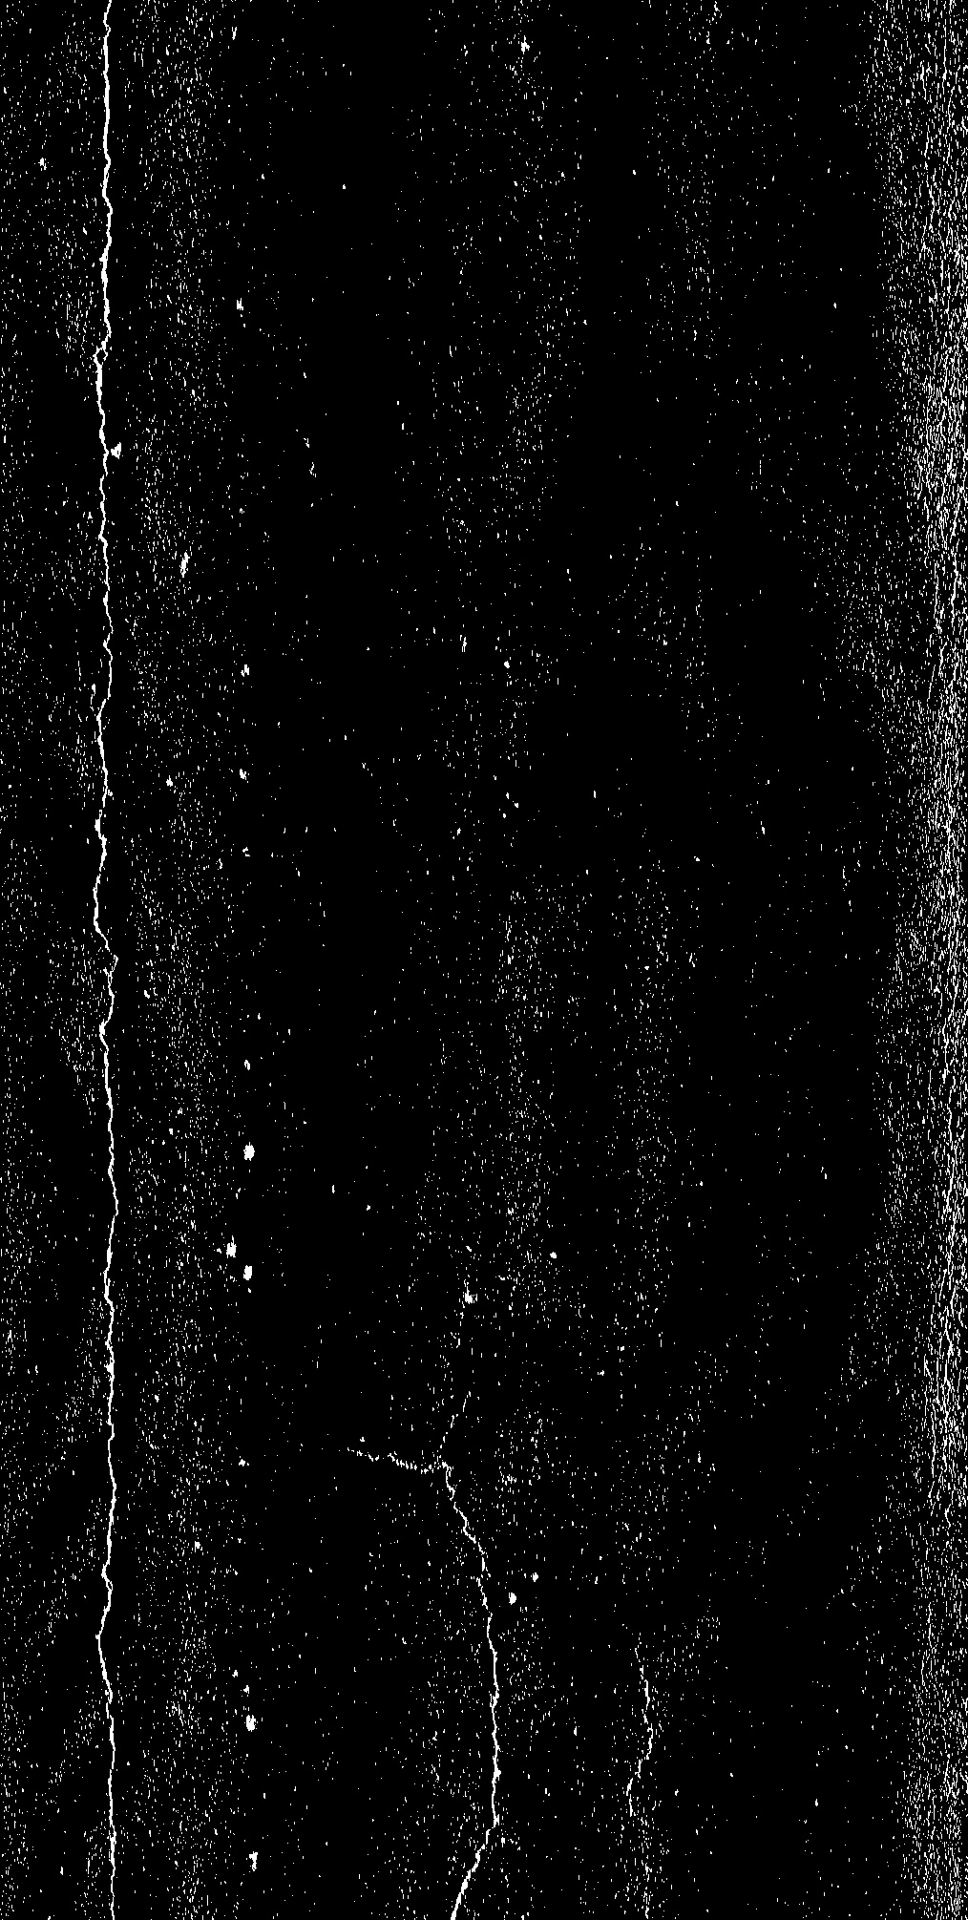
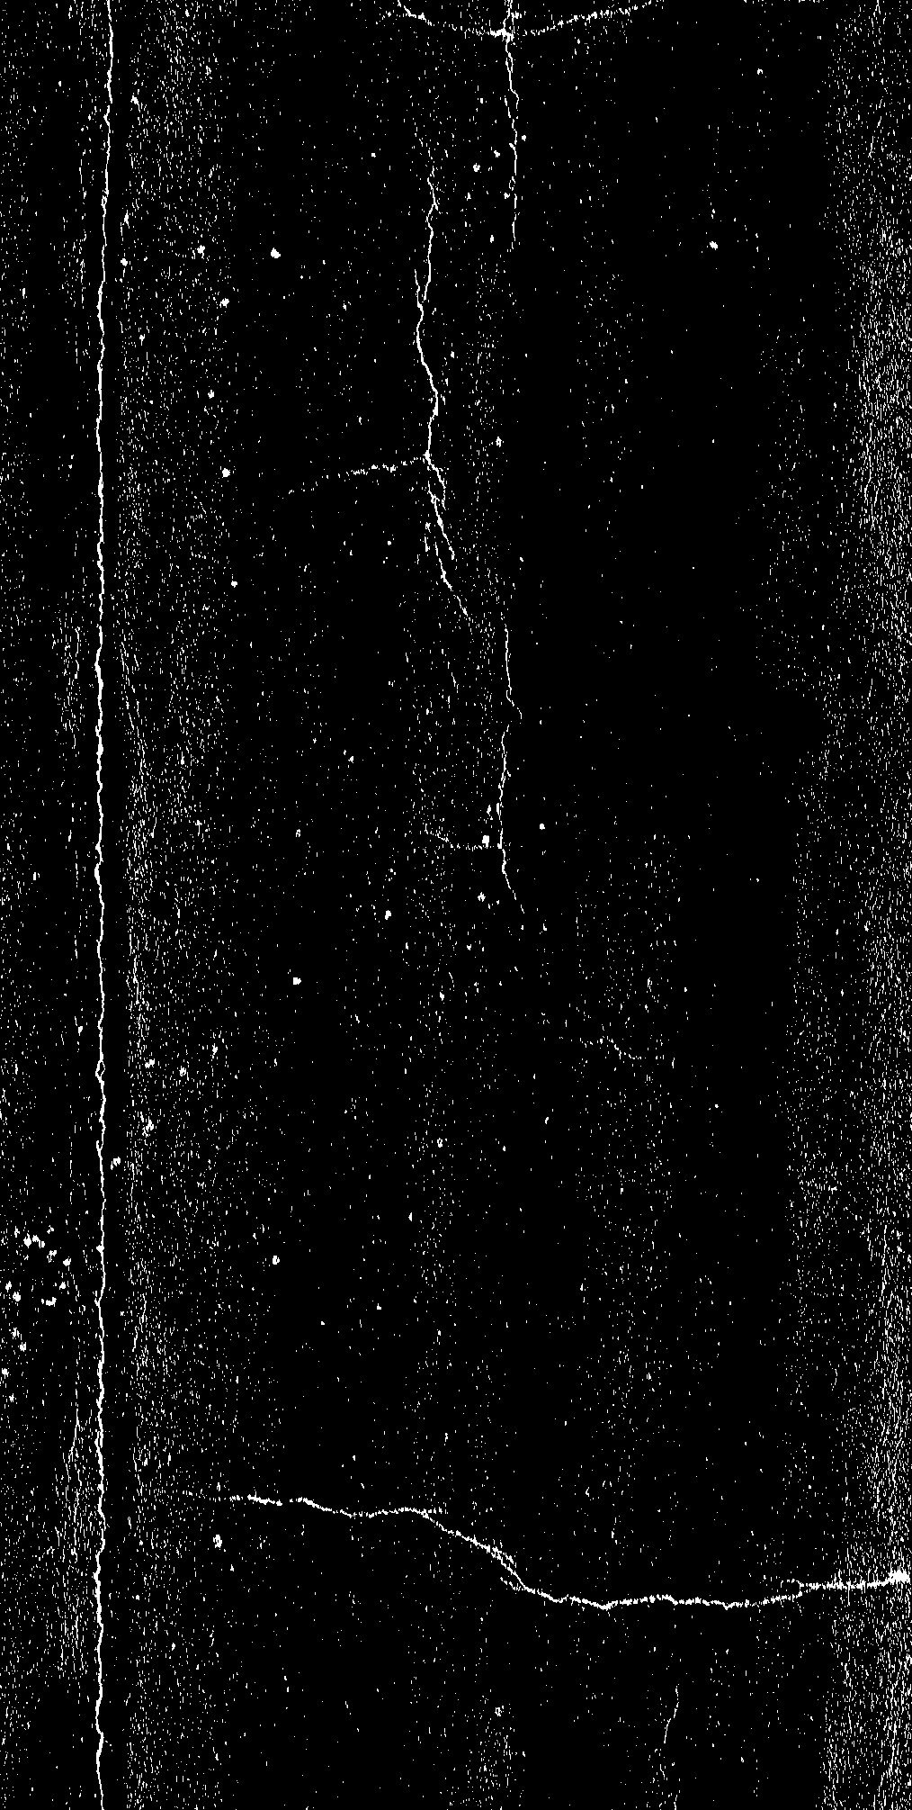
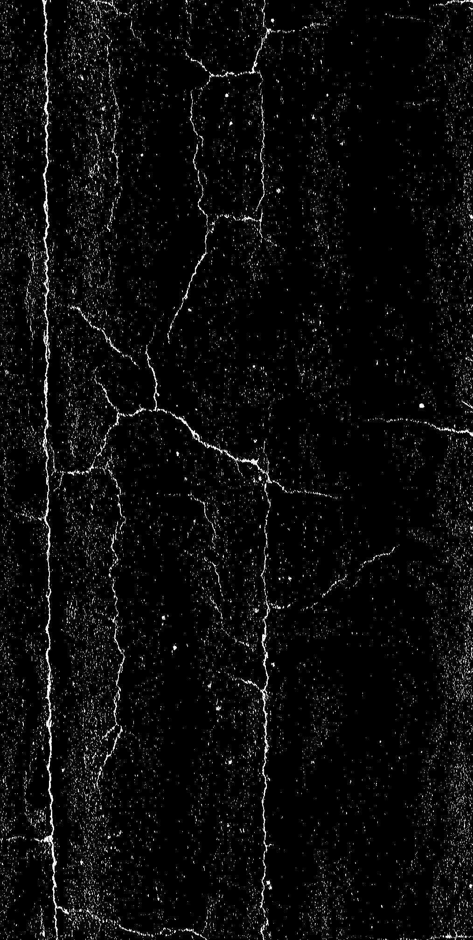
1
6
7
8

Slide 11
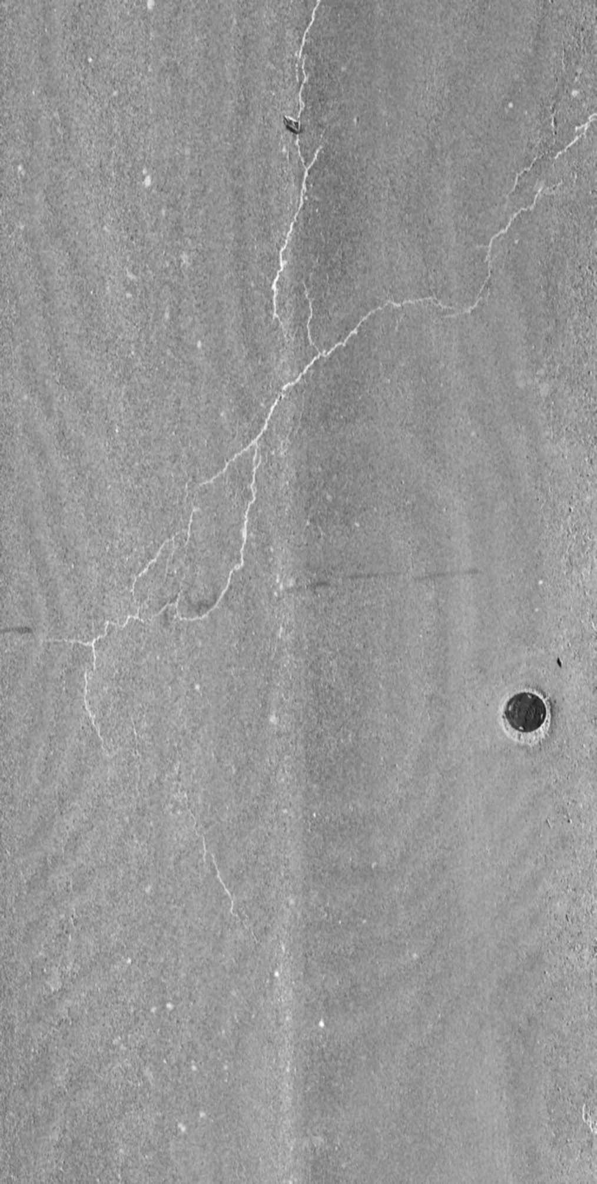
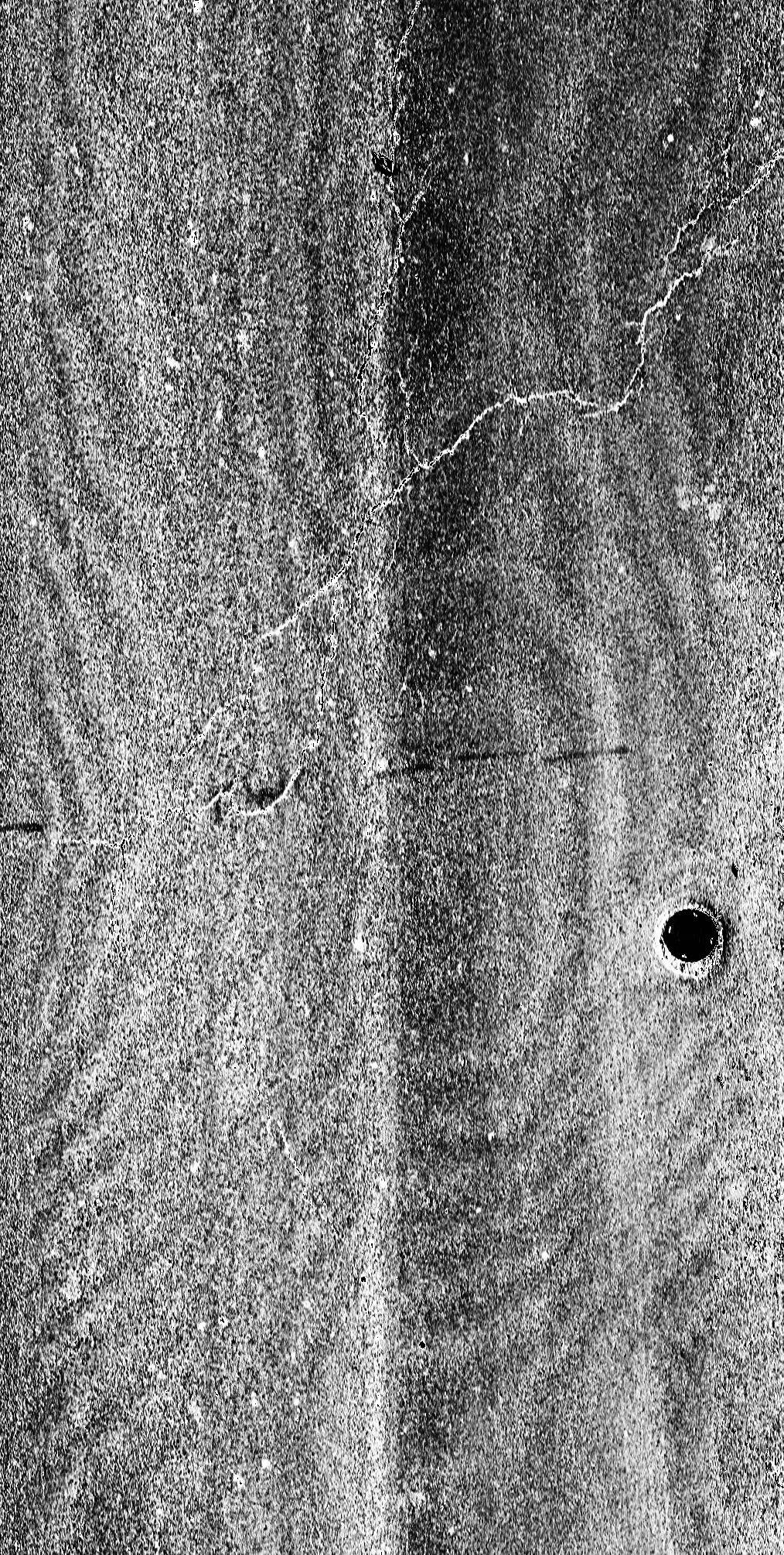
(a)
(b)
(c)
(d)

Slide 12
Pavement images
GAN
Annotation
Training
Validation
Yolov5
Testing

